Slide 1
File handling

Slide 2
File
Collection of related data stored in particular area of disk.
Programs can be designed to perform read/write operations.
A program typically involves any one or both of the following:
  Data transfer between console unit & program.
  Data transfer between program & disk file.

Slide 3
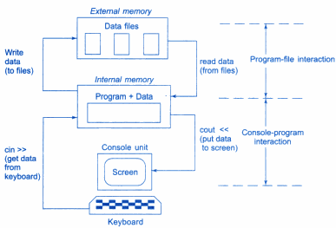
Console-program-file interaction

Slide 4
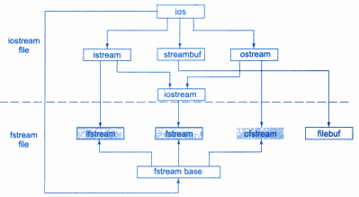
Classes for file-stream operations

Slide 5
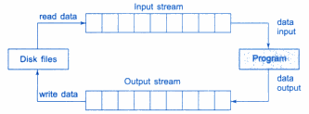
File streams
File streams are used as an interface between program and file.
Input stream → reads data from file
Output stream → writes data to file

Slide 6
File opening
To open a file:
  create a file stream
  link it to filename
File-stream can be defined using classes:
  ifstream, ofstream, fstream
A file can be opened in 2 ways:
  using constructor function of class
  using member function open() class
Used to manage 1 file using a stream
Used to manage multiple files using 1 stream

Slide 7
a) Opening file using constructor
Here, filename is used to initialize file-stream object.
It involves following steps:
  Using appropriate class, create a file-stream object.
    Eg: ofstream → to create o/p stream
  ifstream → to create i/p stream
  2) Initialize object with desired filename.
    Eg: ofstream outfile(“results”);
manages output stream

Slide 8
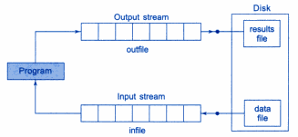
ofstream outfile(“results”)
This statement opens file results and attaches it to output-stream outfile.

Slide 9
Similarly, following statement declares infile as ifstream object and attaches file data for reading:
ifstream infile(“data”)

Slide 10
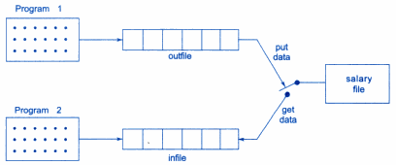
Two File-streams working on same file
When object expires, connection with file is closed automatically.

Slide 11

We can use a single program to do both operations (read & write).
Then, following statements are necessary:

Slide 12
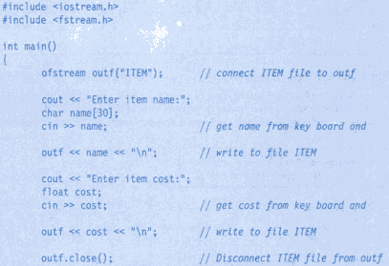

Slide 13

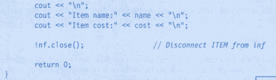

Slide 14
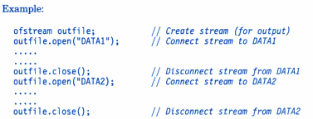
b) Opening file using open()
It is used to open multiple files that use same stream object.
1st file needs to be closed, since stream can be connected to only 1 file at a time.

Slide 15
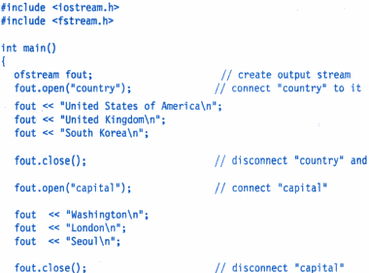

Slide 16
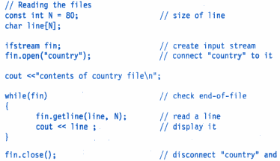

Slide 17
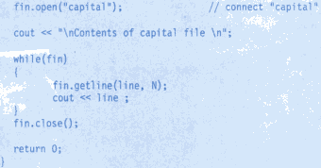

Slide 18
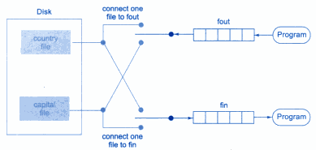

Slide 19
Detecting end-of-file
Detecting end-of-file is necessary for preventing any further reading of data; using statement:
or
Here, ifstream object fin returns value 0 if any error is encountered including eof.
Returns non-zero value when eof occurs

Slide 20

File modes
General form of open() with 2 arguments is:
Prototype of member function contains default values as:
Specifies purpose for which file is opened

Slide 21
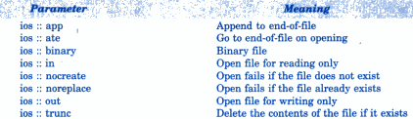
File mode parameters

Slide 22
File pointers
It is of 2 types:
Input pointer (get pointer)
  used to read contents of given file location
Output pointer (put pointer)
  used to write contents to given file location
Used to move through files while reading/writing.
Automatically advances while reading/writing.

Slide 23
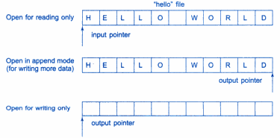
File opened in read mode:
  I/p pointer automatically set at beginning.
File opened in write mode:
  Existing contents deleted & O/p pointers sets at beginning.
To add more data, file is opened in append mode.

Slide 24


File pointer manipulators
These are used to move file pointer to any desired position inside file.

Slide 25


Specifies position from where pointer to be moved
No. of bytes file pointer is to be moved
Takes one of 3 constants:

Slide 26
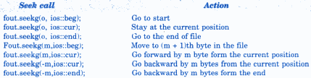
Examples

Slide 27
Sequential Input & Output operations
get() & put() → handle single character at a time.
Example:
char string[80];
fstream file;
file.open(“Text”, ios::in | ios::out);
for(int i=0; i<20; i++)
file.put(string[i]);

